Slide 1
LONGEST INCREASING SUBSEQUENCES
Presented by Team AIN

Slide 2
Course Faculty: Charles Aunkan Gomes
Lecturer, Department of Computer Science and Engineering
United International University
Course Title: Data Structure and Algorithm II Laboratory
Course Code: CSE 2218
Section: C

Slide 3
Group Information
Serial | Full Name | University ID
01 | Azizul Islam Nayem | 011201262
02 | Md.Aman Ullah Faisal | 011192136
03 | Sadman Rafid | 011181029
04 | Nayeem Muhammad Al Farabi Sikder | 011201269
05 | Md Asad Jaman | 011201239

Slide 4
Topics that will be covered here
Problem Description.
Algorithm Explain.
Simulation.
Implementation.
Time Complexity Analysis.

Slide 5
Definition
The longest increasing subsequence refers to the longest sequence of numbers in an array where each number is greater than the one before it. It doesn't have to be consecutive; it's about selecting elements from the array in a way that they're in increasing order.

Slide 6
Usages of LIS
Algorithm Practice: Common problem in algorithm courses and programming contests.
Data Compression: Identifies patterns for efficient data compression.
Financial Analysis: Detects trends in financial data for predictive analysis.
Genomics: Analyzes DNA sequences to uncover genetic patterns.
Network Routing: Optimizes data flow through nodes for better network performance.
Game Theory: Identifies winning strategies in strategy games.
Speech & Language: Extracts patterns in linguistic data for speech and language tasks.
Optimization Problems: Solves various optimization challenges involving ordered sequences.

Slide 7
Problem Description
Given array: {11, 23, 10, 32, 20, 49, 42, 61}
Subsequence: {11} or {11,10,32} or {23,20,61} and so on.
Increasing Subsequence: {11,23,32} or {10,20,49} or {32,49,61} and so on.
Notice that: {11} or {23} or {10} or {32} or {20} or {49} or {42} or {61} is also increasing subsequence.
But, Here, Longest Increasing Subsequence(LIS) is {11,23,32,49,61} or {10,20,32,42,61} and Length is 5.

Slide 8
Solving Technique
To crack the LIS algorithm, our weapon of choice is the dynamic programming approach.
Advantages:
Optimal Substructure: DP breaks the problem into smaller subproblems with clear relationships.
Overlapping Subproblems: DP avoids redundant calculations by storing and reusing results.
Memoization: DP optimizes by saving intermediate results in a table.
Bottom-Up Approach: Solves small sub-problems first and builds up, improving efficiency.
Efficiency: DP improves time complexity compared to recursive approaches.
Ease of Understanding: DP with memoization is intuitive and easier to implement.
Flexibility: Adaptable to handle variations and related problems.

Slide 9
Algorithm
Initialize a DP array dp of the same size as the input array, filled with 1. This array will store the lengths of increasing subsequences ending at each index.
Start iterating through the input array from the second element (index 1) to the last element (index n-1).
For each element at index i, compare it with all the elements before it (from index 0 to i-1).
If the element at index i is greater than the element at index j (where j varies from 0 to i-1), it means we can extend the LIS by including the current element (arr[i]).
Update the dp[i] with the maximum value between its current value and the length of the LIS ending at index j + 1. This step ensures that we consider the longest increasing subsequence ending at index j and append the current element (arr[i]) to it if it can form a longer subsequence.
After the loop ends, the dp array will contain the lengths of the LIS ending at each index.
Find the maximum value in the dp array, which represents the length of the longest increasing subsequence in the given array.
Return the maximum value as the result, which is the length of the LIS.

Slide 10
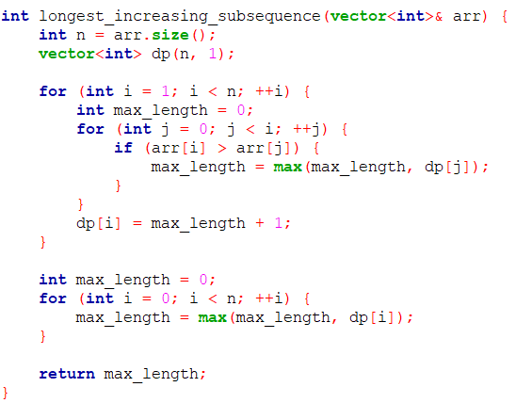
Simulation
For the value of i= 1 and j=0;
iterator | j | i
Array | 11 | 23 | 10 | 32 | 20 | 49 | 42 | 61
LIS | 1 | 1 | 1 | 1 | 1 | 1 | 1 | 1
Initially all 1

Slide 11
For the value of i= 1, j=0;
23>11? Yes. So, LIS = {11,23}
iterator | j | i
Array | 11 | 23 | 10 | 32 | 20 | 49 | 42 | 61
LIS | 1 | 1 2 | 1 | 1 | 1 | 1 | 1 | 1

Slide 12
For the value of i= 2, j=0;
10>11? No. So, LIS = {11,23}
iterator | j | i | i
Array | 11 | 23 | 10 | 32 | 20 | 49 | 42 | 61
LIS | 1 | 2 | 1 | 1 | 1 | 1 | 1 | 1

Slide 13
For the value of i= 2, j=1;
10>23? No. So, LIS = {11,23}
iterator | j | j | i
Array | 11 | 23 | 10 | 32 | 20 | 49 | 42 | 61
LIS | 1 | 2 | 1 | 1 | 1 | 1 | 1 | 1

Slide 14
For the value of i= 3, j=0;
32>11? Yes. But, LIS = {11,23,?}
iterator | j |  | i | i
Array | 11 | 23 | 10 | 32 | 20 | 49 | 42 | 61
LIS | 1 | 2 | 1 | 1 | 1 | 1 | 1 | 1

Slide 15
For the value of i= 3, j=1;
32>23? Yes. But, LIS = {11,23,?}
iterator | j | j |  | i
Array | 11 | 23 | 10 | 32 | 20 | 49 | 42 | 61
LIS | 1 | 2 | 1 | 1 2 | 1 | 1 | 1 | 1

Slide 16
For the value of i= 3, j=2;
32>10? No. So, LIS = {11,23,32}
iterator |  | j | j | i
Array | 11 | 23 | 10 | 32 | 20 | 49 | 42 | 61
LIS | 1 | 2 | 1 | 2 3 | 1 | 1 | 1 | 1

Slide 17
For the value of i= 4, j=0;
20>11? Yes. But, LIS = {11,23,32,?}
iterator | j |  |  | i | i
Array | 11 | 23 | 10 | 32 | 20 | 49 | 42 | 61
LIS | 1 | 2 | 1 | 3 | 1 | 1 | 1 | 1

Slide 18
For the value of i= 4, j=1;
20>23? No. So, LIS = {11,23,32}
iterator | j | j |  |  | i
Array | 11 | 23 | 10 | 32 | 20 | 49 | 42 | 61
LIS | 1 | 2 | 1 | 3 | 1 2 | 1 | 1 | 1

Slide 19
For the value of i= 4, j=2;
20>10? Yes. But, LIS = {11,23,32}
iterator |  | j | j |  | i
Array | 11 | 23 | 10 | 32 | 20 | 49 | 42 | 61
LIS | 1 | 2 | 1 | 3 | 2 | 1 | 1 | 1

Slide 20
For the value of i= 4, j=3;
20>32? No. So, LIS = {11,23,32}
iterator |  |  | j | j | i
Array | 11 | 23 | 10 | 32 | 20 | 49 | 42 | 61
LIS | 1 | 2 | 1 | 3 | 2 | 1 | 1 | 1

Slide 21
For the value of i= 5, j=0;
49>11? Yes. But, LIS = {11,23,32,?}
iterator | j |  |  |  | i | i
Array | 11 | 23 | 10 | 32 | 20 | 49 | 42 | 61
LIS | 1 | 2 | 1 | 3 | 2 | 1 | 1 | 1

Slide 22
For the value of i= 5, j=1;
49>23? Yes. But, LIS = {11,23,32,?}
iterator | j | j |  |  |  | i
Array | 11 | 23 | 10 | 32 | 20 | 49 | 42 | 61
LIS | 1 | 2 | 1 | 3 | 2 | 1 2 | 1 | 1

Slide 23
For the value of i= 5, j=2;
49>10? Yes. But, LIS = {11,23,32,?}
iterator |  | j | j |  |  | i
Array | 11 | 23 | 10 | 32 | 20 | 49 | 42 | 61
LIS | 1 | 2 | 1 | 3 | 2 | 2 3 | 1 | 1

Slide 24
For the value of i= 5, j=3;
49>32? Yes. But, LIS = {11,23,32,?}
iterator |  |  | j | j |  | i
Array | 11 | 23 | 10 | 32 | 20 | 49 | 42 | 61
LIS | 1 | 2 | 1 | 3 | 2 | 3 | 1 | 1

Slide 25
For the value of i= 5, j=4;
49>20? No. So, LIS = {11,23,32,49}
iterator |  |  |  | j | j | i
Array | 11 | 23 | 10 | 32 | 20 | 49 | 42 | 61
LIS | 1 | 2 | 1 | 3 | 2 | 3 4 | 1 | 1

Slide 26
Same steps goes,
for of i= 6, when j= 0-5; and,
for of i= 7, when j= 0-5;
That’s why skipping those steps.

Slide 27
For the value of i= 7, j=6;
Finally,
61>42? Yes. So, LIS = {11,23,32,49,61}
iterator |  |  |  |  |  |  | j | i
Array | 11 | 23 | 10 | 32 | 20 | 49 | 42 | 61
LIS | 1 | 2 | 1 | 3 | 2 | 4 | 1 2 3 4 | 1 2 3 4 5
Return maximum length

Slide 28
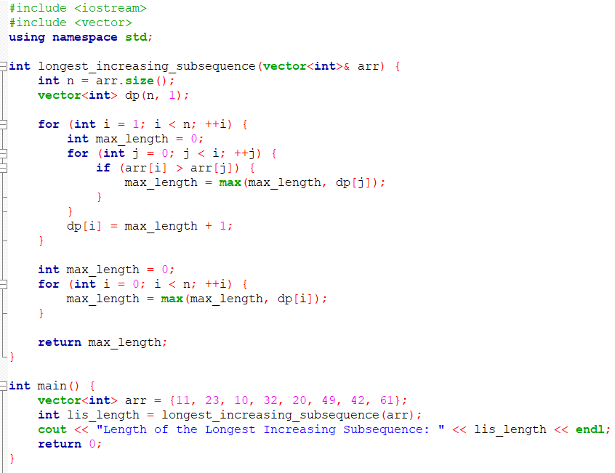
Implementation

Slide 29
Time Complexity Analysis
O(1)
Total: O(n^2)
O(n^2)
O(n^2)

Slide 30
To Improve the overall time complexity we have another algorithm called Patience Sorting(optimized dp approach).
O(n^2)------>O(nlogn).

Slide 31
Patience Sorting Concepts
This technique basically uses binary search and essentially breaks down the problem of finding the LIS into a visual and intuitive process of building piles. The length of the LIS is equivalent to the number of piles formed, and the actual LIS can be reconstructed by tracing back through the piles.
N.B. While Patience Sort is a helpful conceptual tool for understanding the LIS problem, it might not be the most efficient algorithm for finding the LIS, especially for larger input sequences. More efficient algorithms like dynamic programming (as shown in our initial code) are commonly used to solve the Longest Increasing Subsequence problem in practice.

Slide 32
Algorithm
Start with an empty array to represent piles. The piles will store elements forming increasing subsequences.
Iterate through the elements of the input array.
For each element, find the pile where the element can be placed using binary search on the piles array.
If the element should be placed at the end of the piles, create a new pile with that element.
If the element should be placed in between existing piles, update the existing pile with the element.
Continue this process for all elements in the input array.
The number of piles formed represents the length of the LIS.
The elements in the piles, in the order they appear, form the Longest Increasing Subsequence.

Slide 33
Simulation
Element (arr[i]) | Current Piles | Explanation
11 | [11] | Create a new pile since piles is empty.
23 | [11,23] | Create a new pile since 23 > 11.
10 | [10,23] | Replace 11 with 10 as 10 < 11 and 10 < 23.
32 | [10,23,32] | Create a new pile since 32 > 23.
20 | [10,20,32] | Replace 23 with 20 as 20 < 23 and 20 < 32.
49 | [10,20,32,49] | Create a new pile since 49 > 32.
42 | [10,20,32,42] | Replace 49 with 42 as 42 < 49.
61 | [10,20,32,42,61] | Create a new pile since 61 > 42.

Slide 34
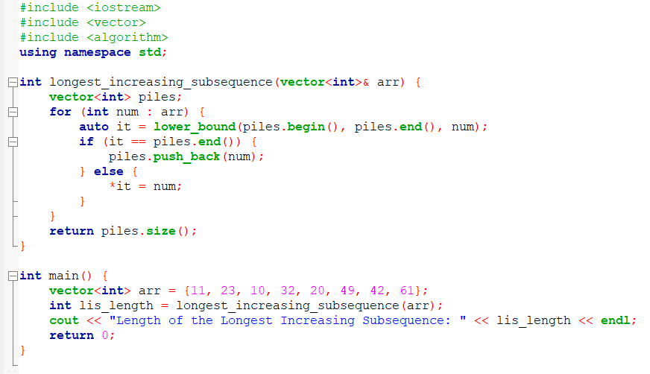
Implementation

Slide 35
Time Complexity Analysis
Total: O(nlogn)
O(1)
O(n*logn)
O(n*logn)

Slide 36
THANK YOU

Slide 37
Contributions
University ID | Full Name | Topics
011201262 | Azizul Islam Nayem | DP-> Algorithm, Simulation, Codes,Time Complexity.
011192136 | Md.Aman Ullah Faisal | DP-> Definition, Usage of LIS, Problem Description.
011181029 | Sadman Rafid | Patience Sorting-> Concepts, Algorithm.
011201269 | Nayeem Muhammad Al Farabi Sikder | Patience Sorting-> Codes, Time Complexity.
011201239 | Md Asad Jaman | DP-> Solving Technique, Simulation(Patience sorting).

